Slide 1
3D Slam – Update 3
Michael Willett

Slide 2
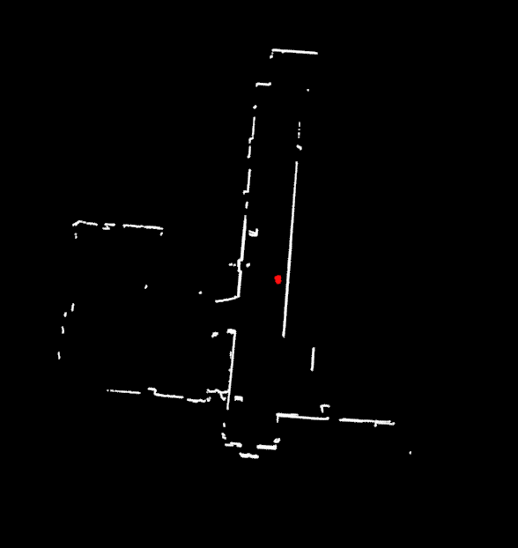
Milestones
Visualization using PCL on Occupancy Grid Maps
Construction of map using point cloud data
Particle Evaluation using point cloud data

Slide 3
PCL Integration
Installing PCL and Loading into Project:
PCL has several separate library dependencies and exact version requirements are inconsistent (Boost, Eigen, FLANN, Qt, VTK, Qhull, OpenNI)
Several all-in-one installers exist that include dependencies, but the included libraries did not compile properly, requiring additional troubleshooting
First attempt at using PCL was as a visualizer for previous ICP project. However, for some reason the makefile settings were not properly including Boost library, resulting in issues with exception handling.
PCL demo’s were working, and the project compiled when using Boost includes, but adding PCL headers resulted in Boost breaking.
When installing PCL on a separate project, everything compiled fine. I still have no idea why the ICP project will not compile with PCL includes.
Verification of visualization tools was relatively straightforward: search over occupancy grid and generate a point wherever there was any wall confidence.
PCL rendering added substantial run time overhead, dropping speeds to about 30FPS. Further investigation needs to be done

Slide 4
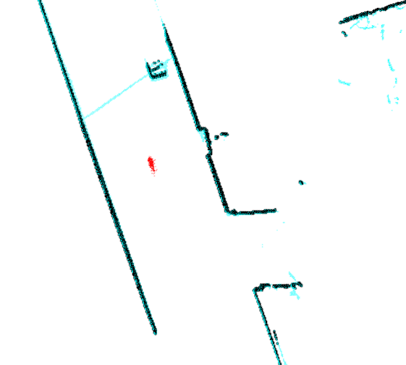
Creating Point Cloud Maps
We cannot simply calculate scan readings to absolute positions relative the robot. Each point in the map has a volume, and we do not want to create duplicate points for the same voxel
Solution is to round the calculated point to the nearest voxel, and then search the PC to see if a previous scan found an intersection at that point. Points are stored in KD tree for fast searching
Current unsolved problem: Finding map correspondences with occlusions works fairly well, however, the algorithm relies on down-weighting voxels it knows to be “free”. Current implementation using Bresenham’s line to calculate free cells and reduce the probability of that voxel containing a wall. Correspondences for this are not as accurate was wall detection. (See left)
Mapping: blue is PC data, black is map from occupancy grid

Slide 5
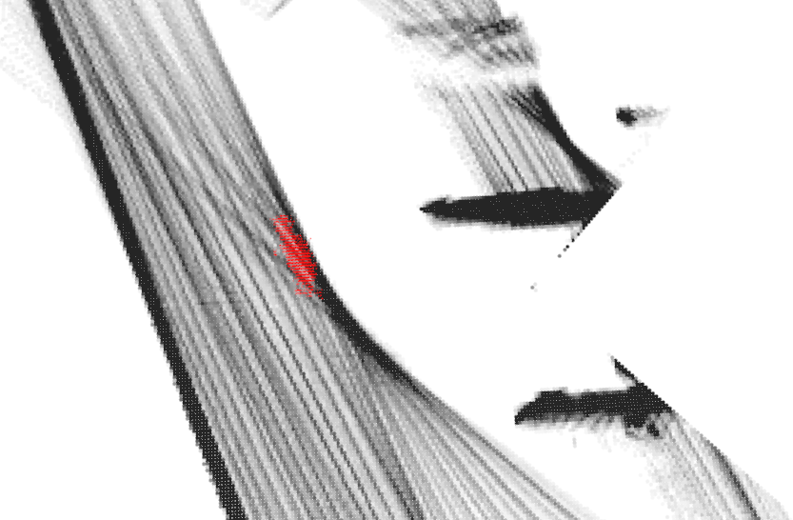
Localization
Still using a particle filter for estimating position, but similar to the map update, we need to find correspondences between LIDAR scan points and map PC.
Particle weight is calculated using similar metric to occupancy grid, however, we allow some additional leniency for imperfect map updates.
The goal for true 3d data is to use weighted closest point least-squares metric for properly including both the wall distribution probabilities with correspondence distances, but is currently not implemented.
Localization: bad rotation, but PF is aligning to corridor

Slide 6
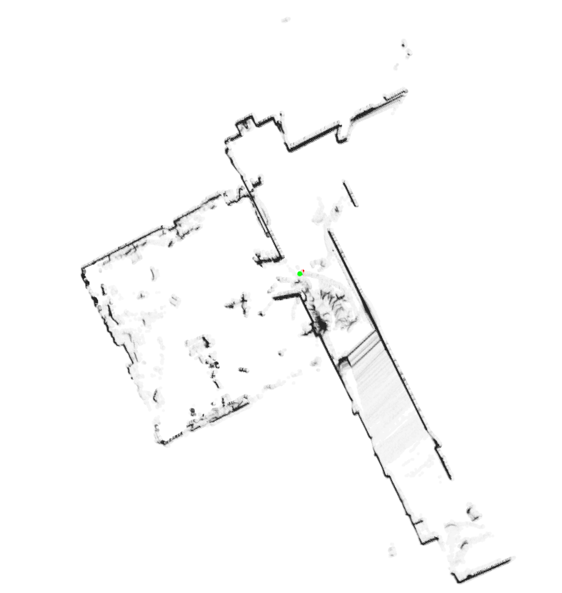
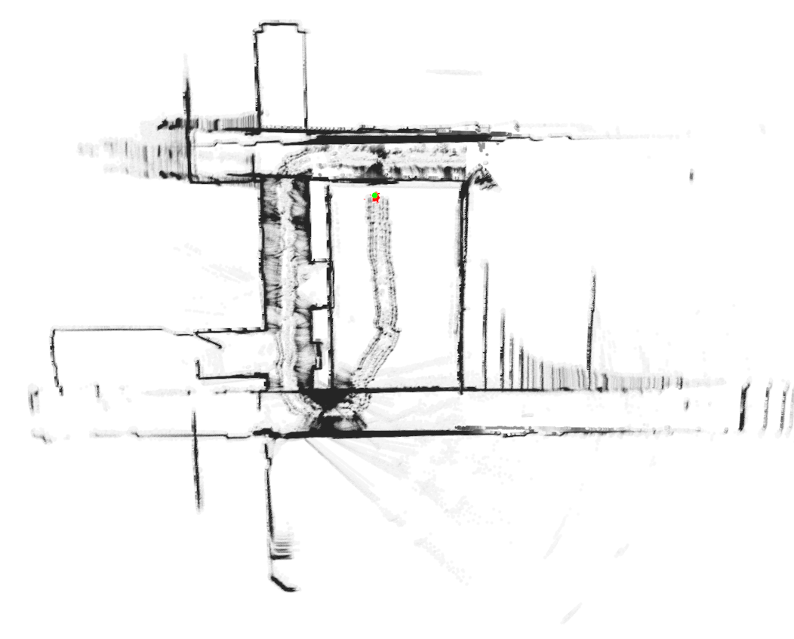
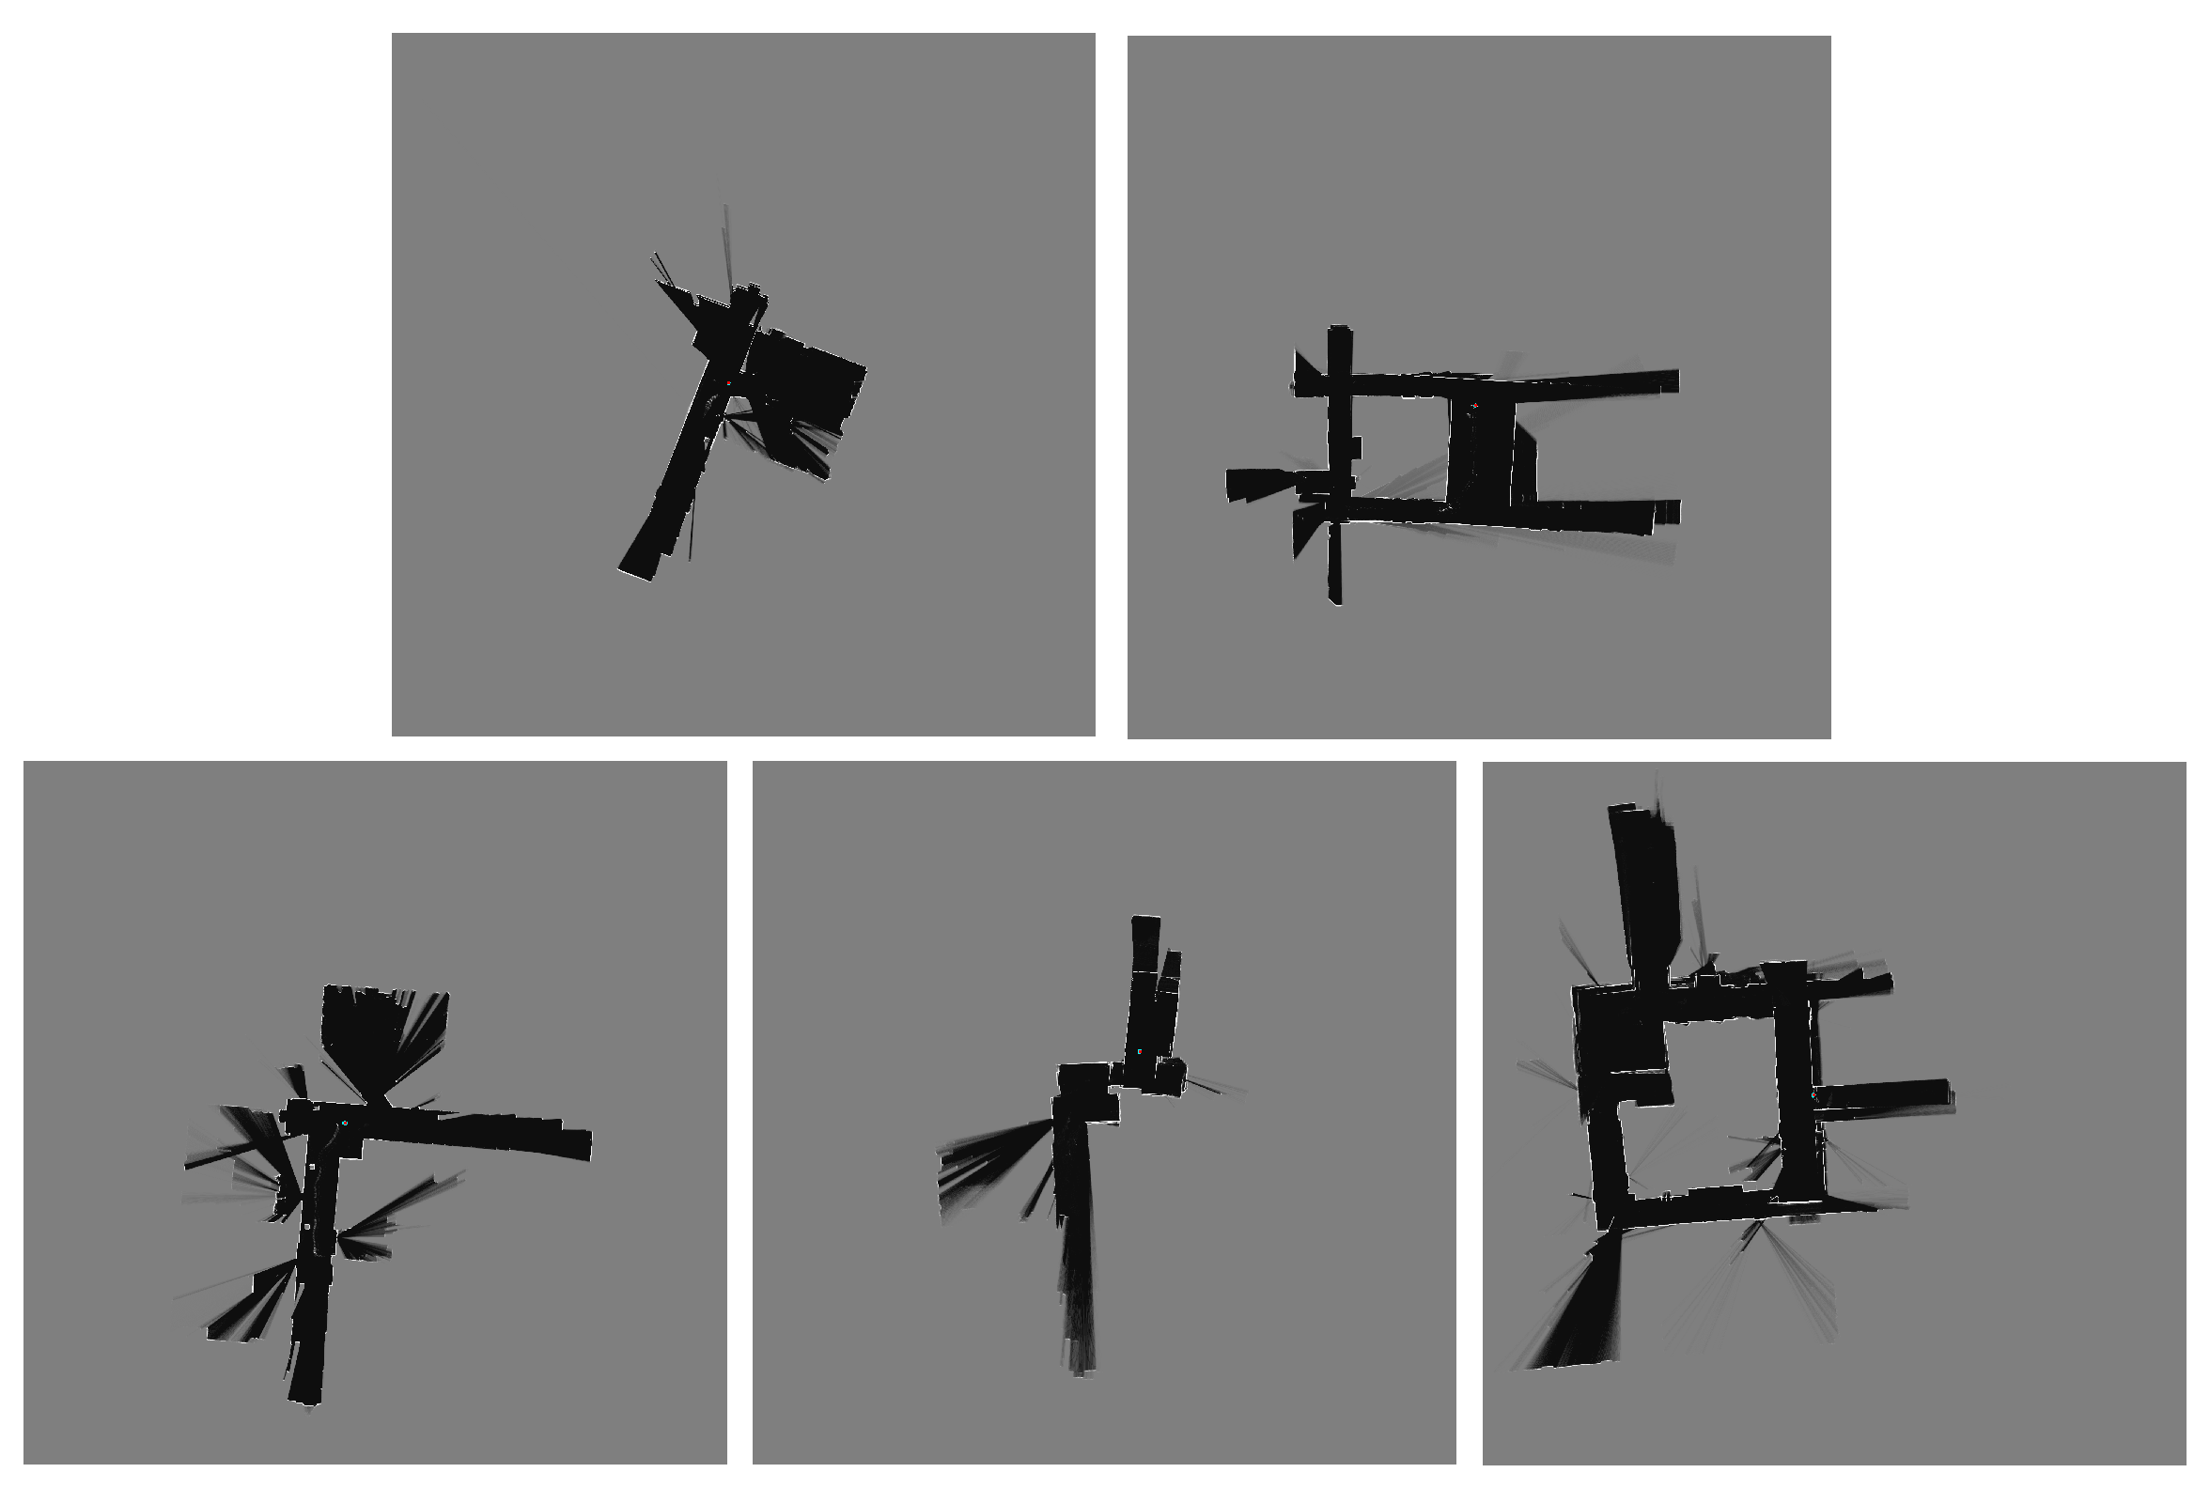
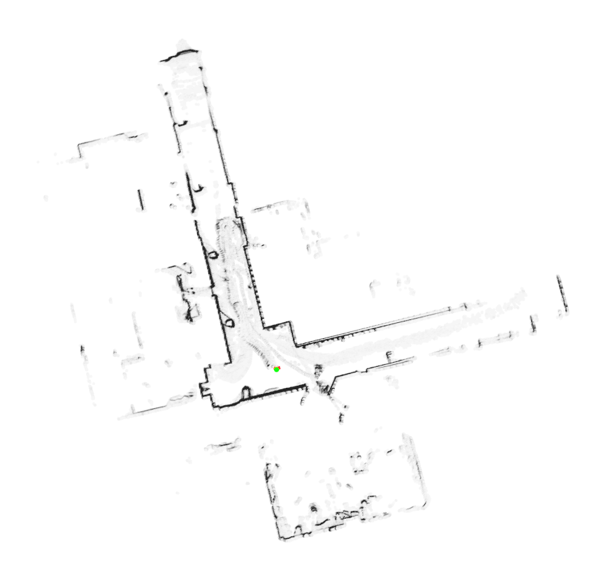
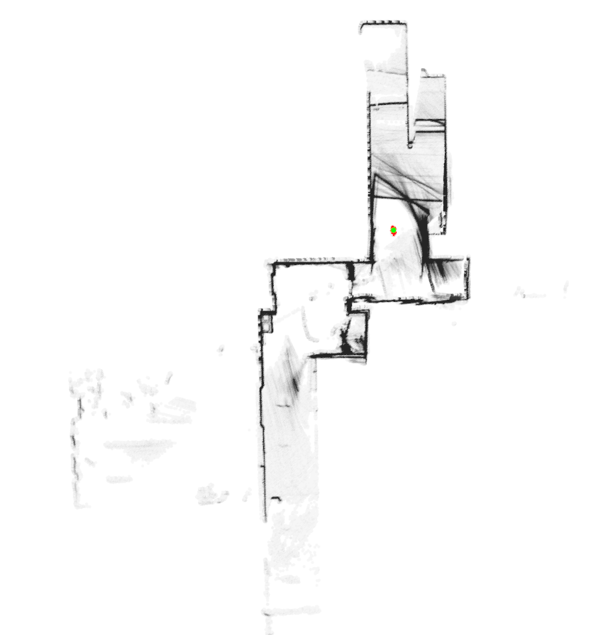
Results

Slide 7
Next Steps
Investigate Performance Effects:
Currently the search through KD tree results in decreased runtime, though that was expected.
Ad hoc testing shows surprisingly little run time effect from moving between 500 particles and 5000 particles. Drop off appears between 10000-15000 particles, though more though analysis is required.
Currently there is no rebalancing or pruning of the KD Tree through insertions. Maps will typically generate 200-500 thousand points (occupancy grid settings recorded 2.56 million), which shows some memory efficiency, but this could be improved with periodic cleaning of the map. This may additionally help with failure to down-weighting free cells
Investigate runtime costs of active loop closure when using PC based maps
Test accuracy of including a single iteration of ICP alignment to better estimate robot position after best candidate particle has been detected every iteration. Initial testing shows relatively little overhead relative to point cloud evaluation.

Slide 8
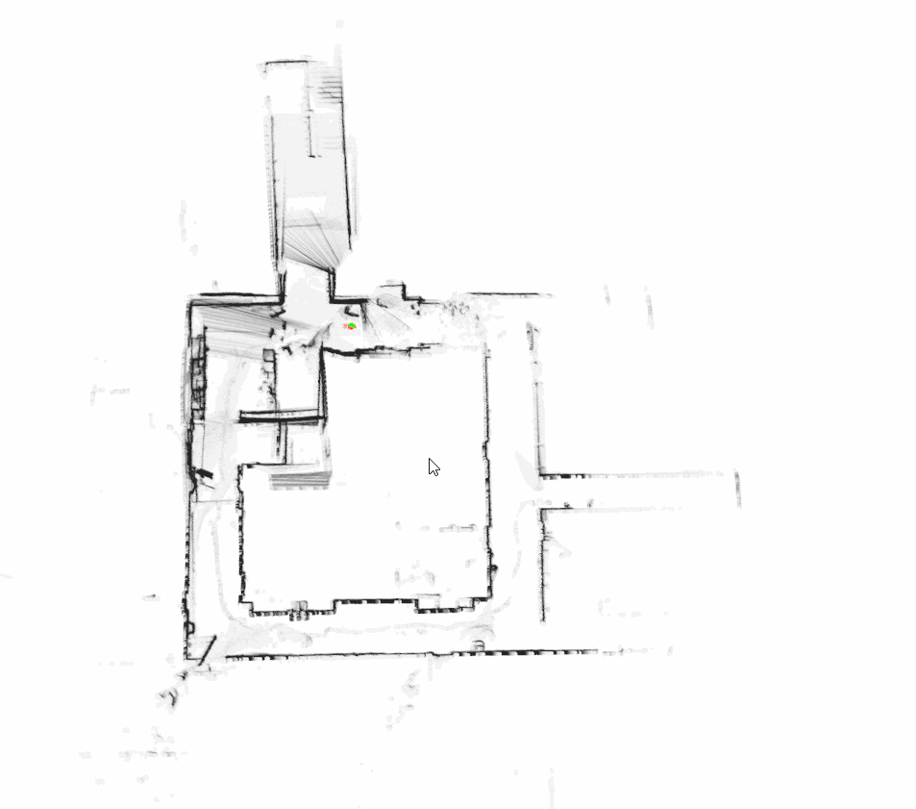
PCL Visualization Tool

